Slide 1
Where is Papa John Moving To?

Slide 2


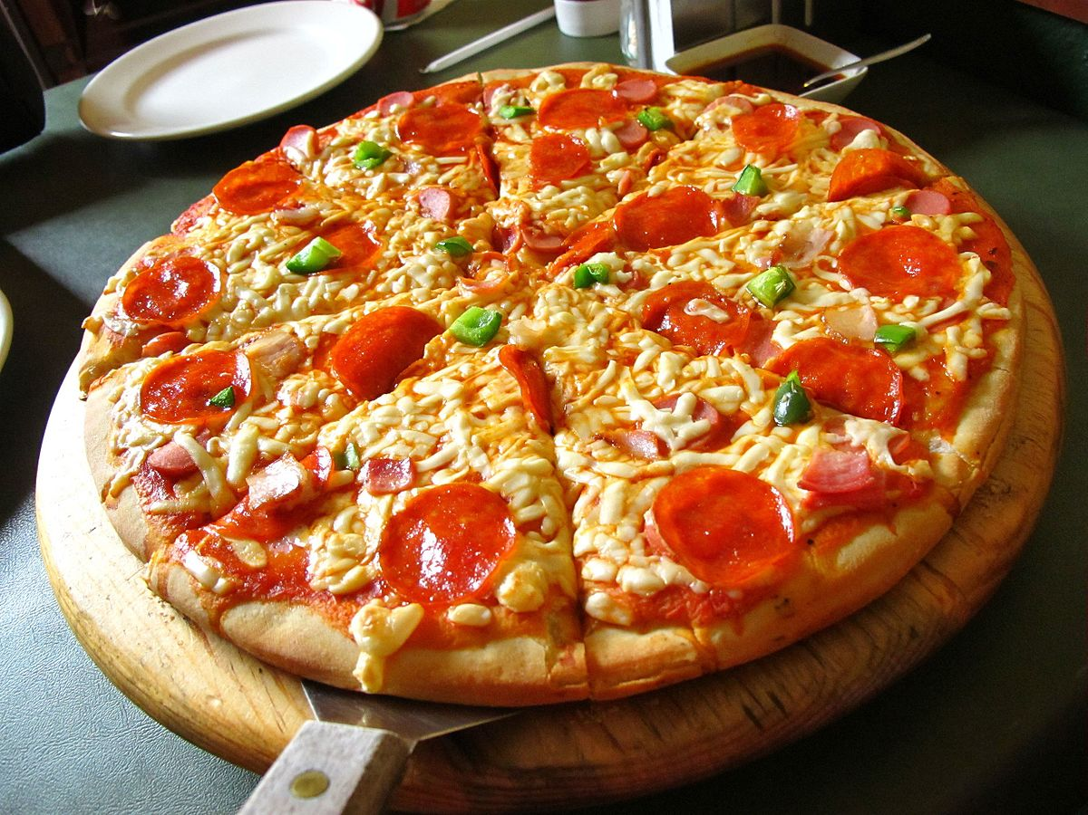
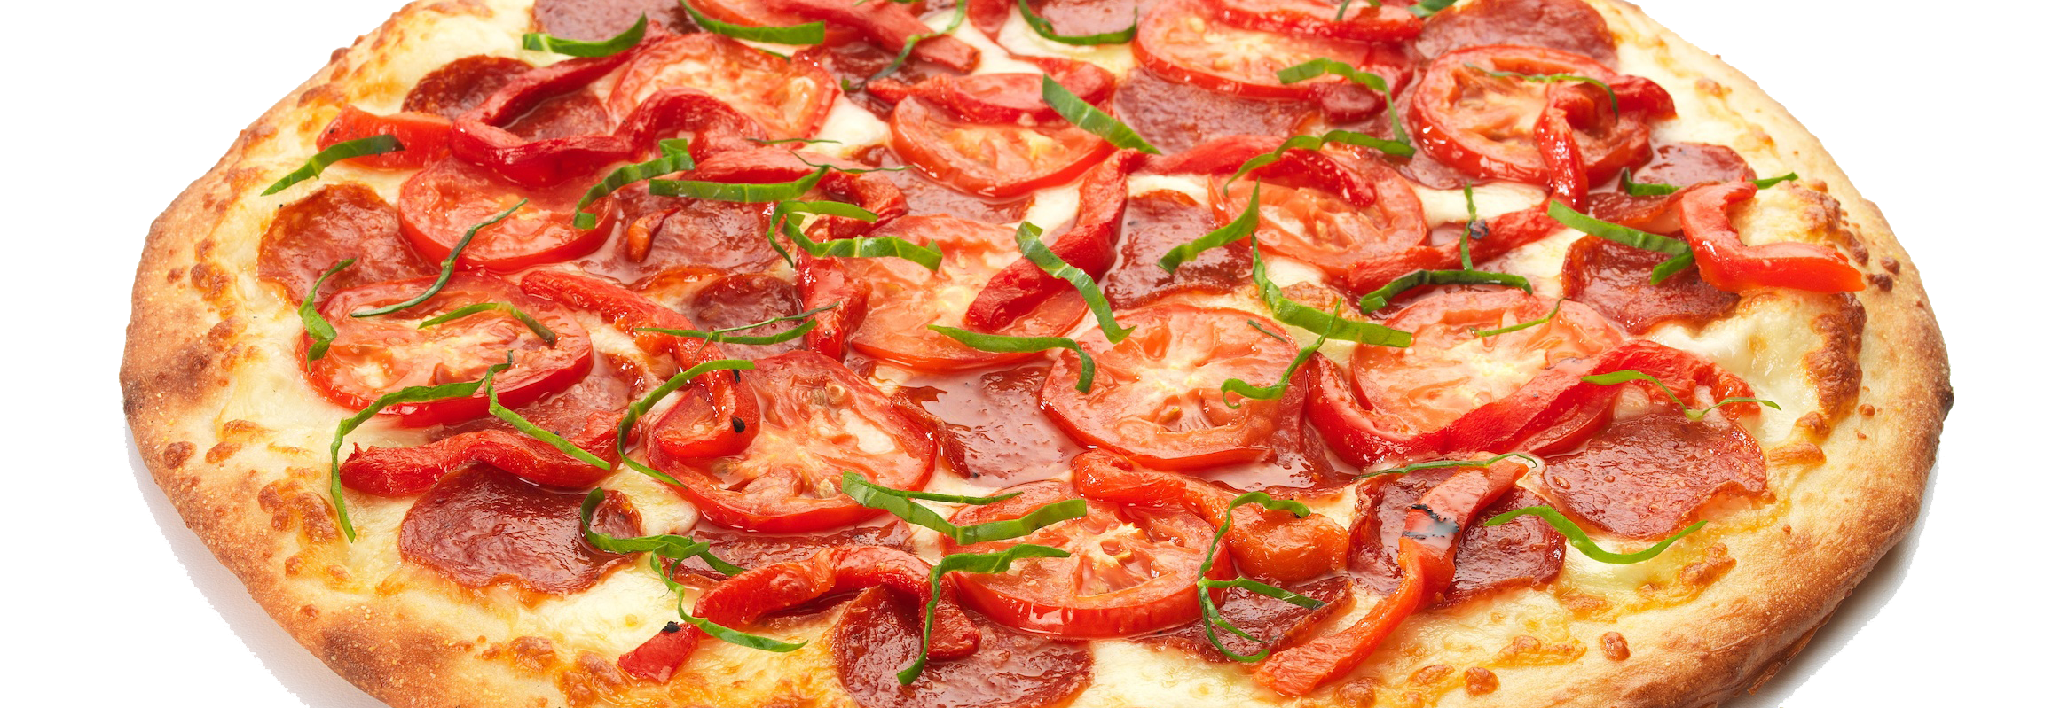
Introduction
I love pizza! I like deep dish, New York style, thin crust and even Pizza rolls.
I can now move to any city with a good internet connection and enjoy as much pizza as I want.
My goal for this move is to find a medium sized city with the most Pizza places per capita.
This Photo by Unknown Author is licensed under CC BY-NC-ND
This Photo by Unknown Author is licensed under CC BY-NC
This Photo by Unknown Author is licensed under CC BY-SA
This Photo by Unknown Author is licensed under CC BY-SA

Slide 3
Data Acquisition and Cleaning
Two Data Sources
Wikipedia for US Cities and Population
https://en.wikipedia.org/wiki/List_of_United_States_cities_by_population
FourSquare – Location data for Pizza Shops

Slide 4
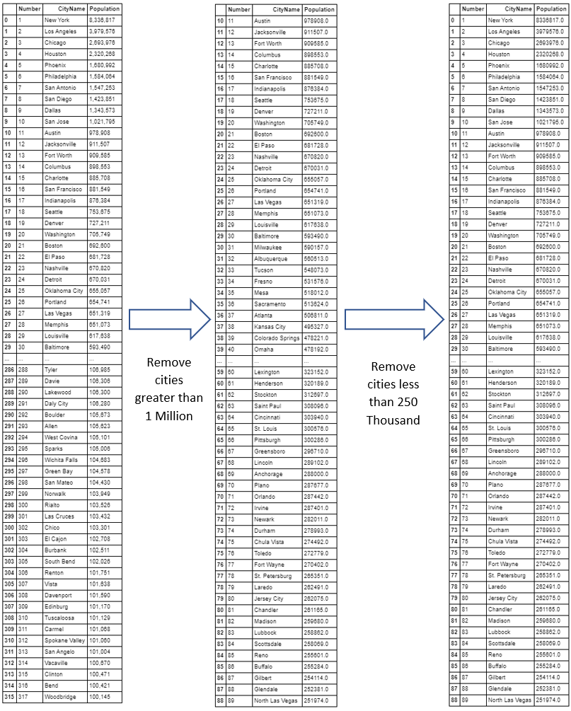
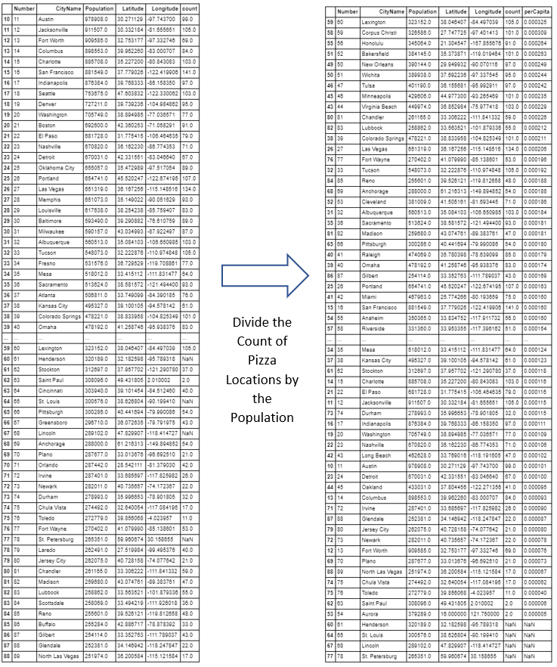
Data Cleaning

Slide 5
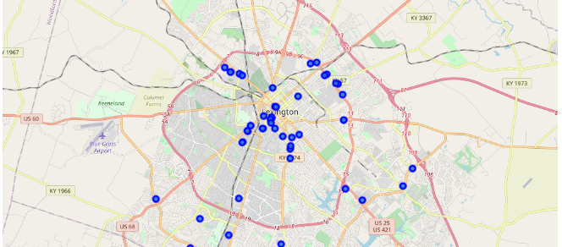
Exploratory Data Analysis

Slide 6
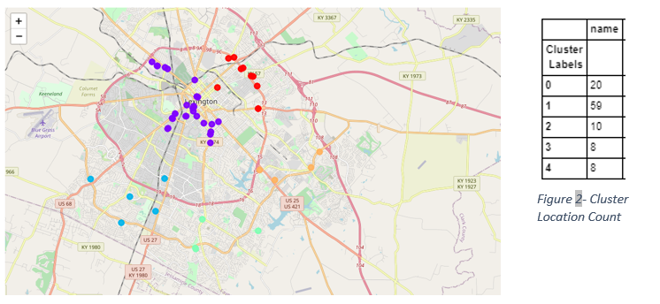
Data Regression

Slide 7
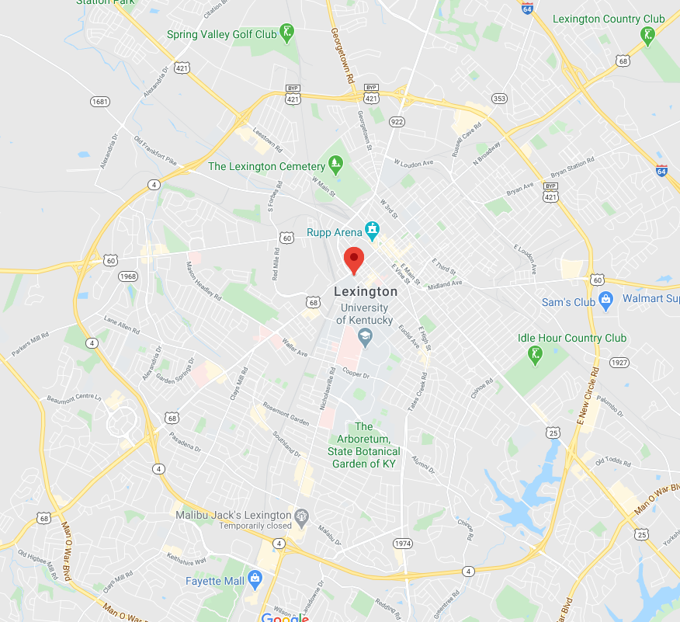
Conclusion
Lexington KY is the place for me.
105 Pizza Shops in the 5 km radius
59 Locations grouped around Cener Court Condos
https://github.com/Maxizarius/datasciencecoursera/blob/master/The%20Battle%20of%20Neighborhoods.ipynb

